Slide 1
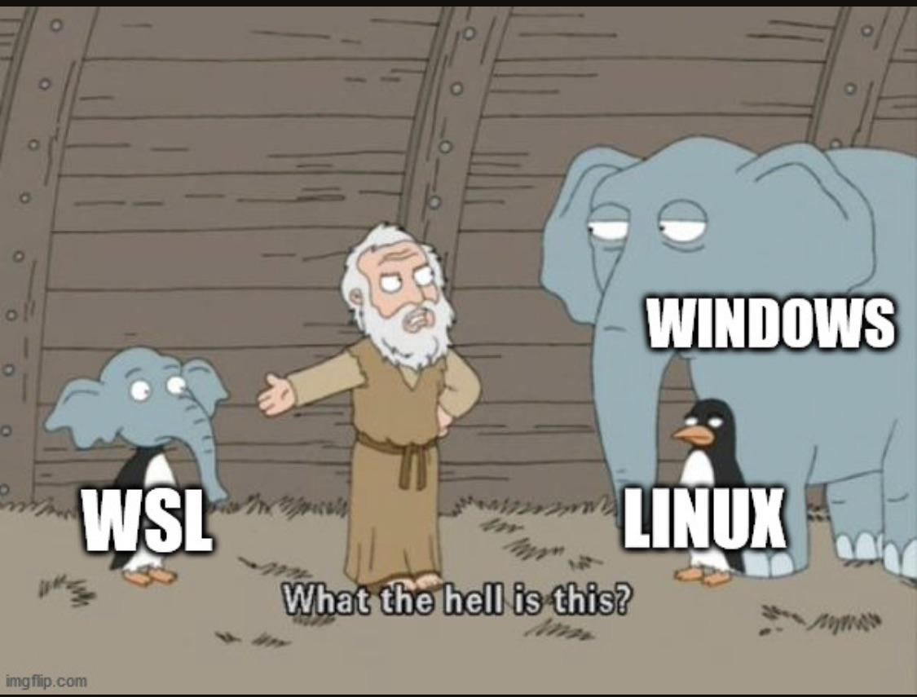


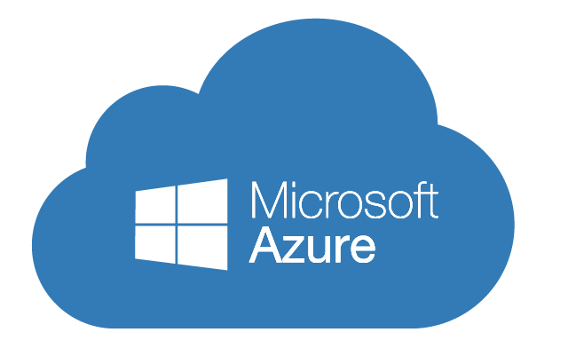
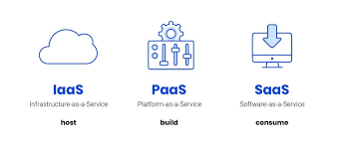
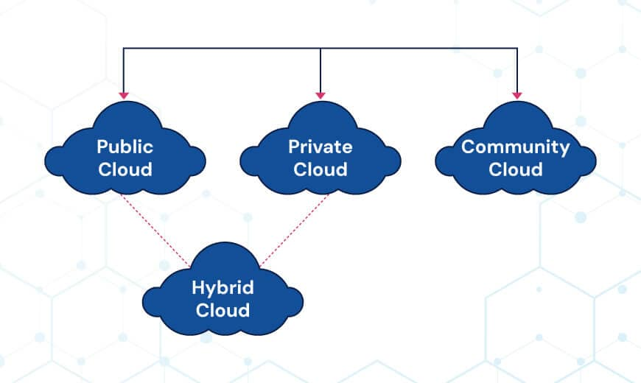
Agenda
Kernel, System Calls, User Space
Cli Fundamentals
  Shell, Command, Prompt
WSL v1
WSL v2
Commands Cheat Sheet
Practice Lab

Slide 2
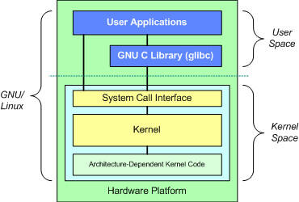
Command Line Interface
A Command Line Interface (CLI) is
  A text-based way of interacting with a computer.
  Instead of clicking icons and buttons (a GUI — Graphical User Interface), you type commands into a program called a shell, and the computer executes them. Cli falls under user space in OS domain.
Terminal
  The application/window you type into (e.g., Terminal.app, Windows Terminal, GNOME Terminal).
Shell
  The program that actually interprets your commands (e.g., bash, zsh, PowerShell). The terminal is the "window," the shell is the "brain" behind it.
Prompt
  The line where you type, usually showing your username, machine name, and current directory, e.g.:

Slide 3
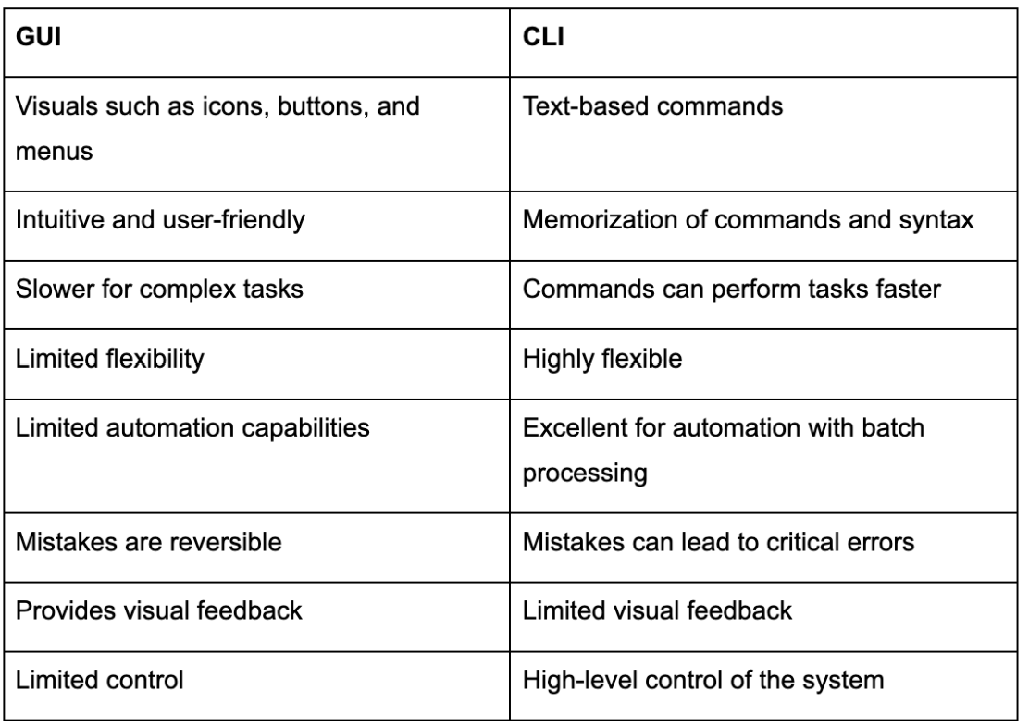
Why Cli for DevOps?
No GUI on servers
  Cloud VMs ship headless. SSH + CLI is the only access path.
Automation & Scripting
  Bash scripts, cron jobs, and CI pipelines run CLI commands and not mouse clicks.
Reproducibility
  A shell script is infrastructure documentation. Anyone can re-run it identically.
Resource Efficiency
  No desktop = more RAM/CPU for your workloads. Critical at scale.

Slide 4
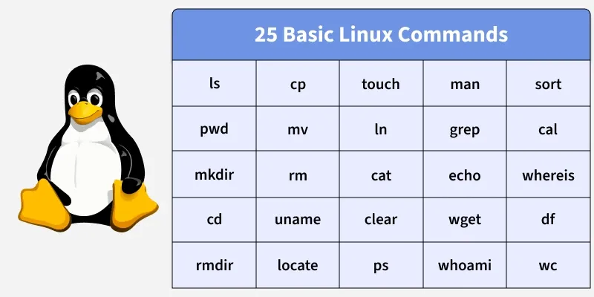
Linux, Unix & WSL
Unix is a family of operating systems that originated at Bell Labs around 1969
Linux is the kernel. A distribution (Ubuntu, Debian) bundles the complete OS using
  kernel
  GNU user-space tools
  package management
  applications
Linux is inspired by Unix concepts but does not descend from Unix source code.
WSL lets you run a Linux environment directly on Windows, so Windows users can use Linux commands and tools without replacing Windows or setting up a traditional VM manually.

Slide 5

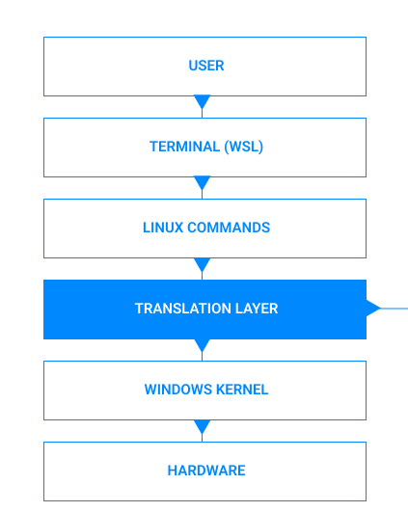
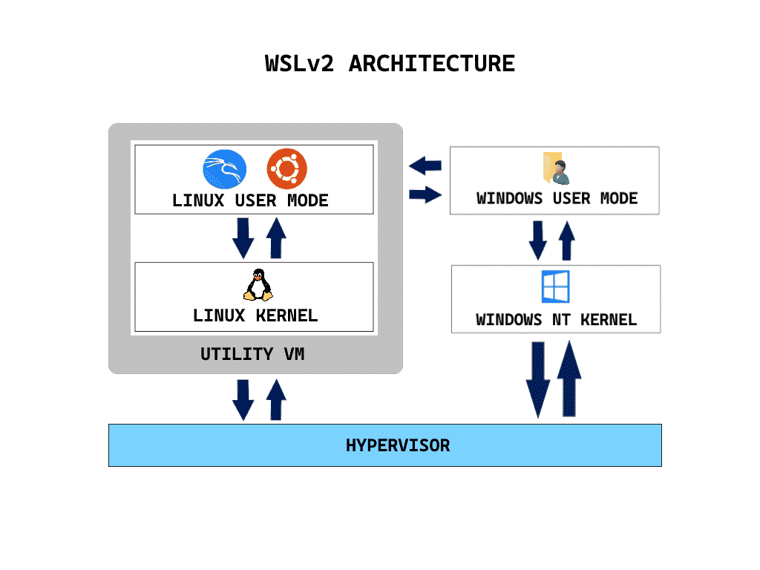
WSL v1 vs WSL v2

Slide 6
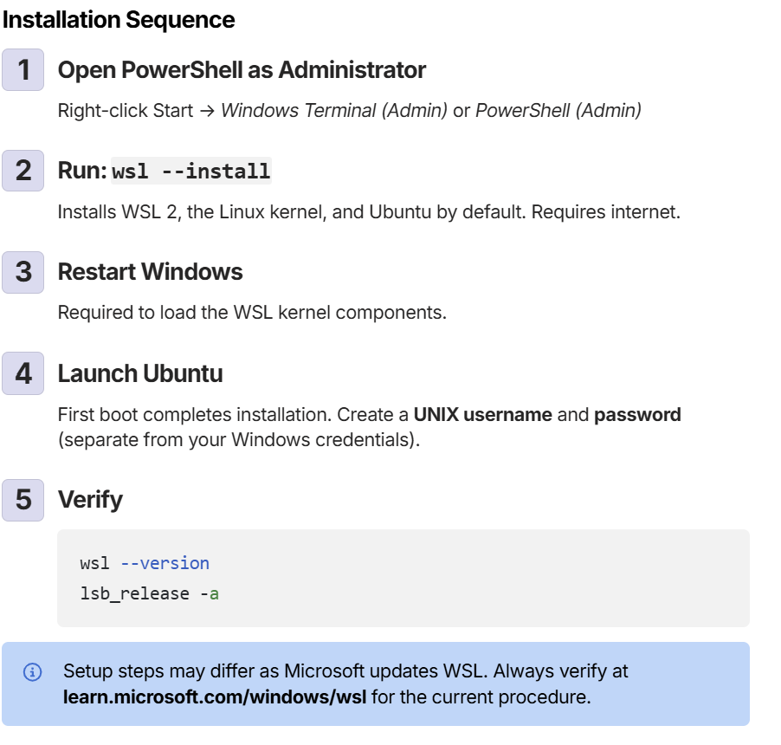
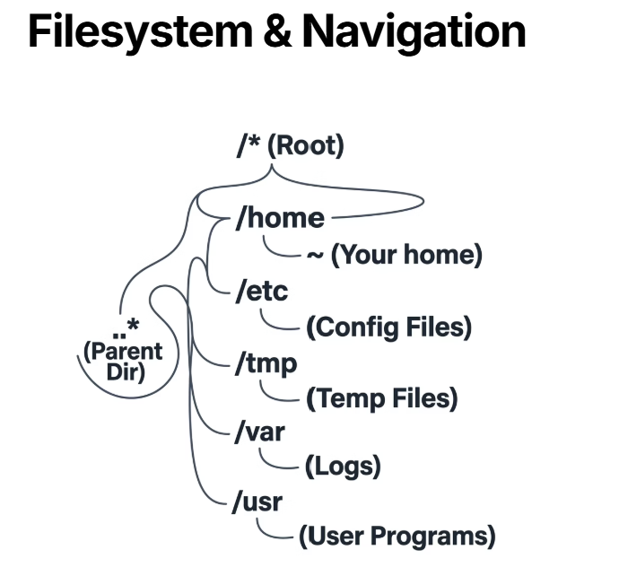
Linux File System & WSL Installation

Slide 7
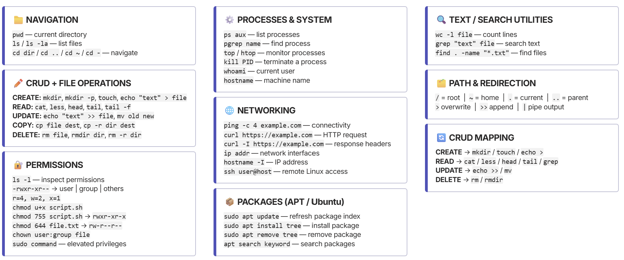
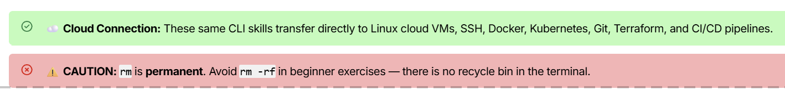
Linux Commands Cheat Sheet (Link)

Slide 8
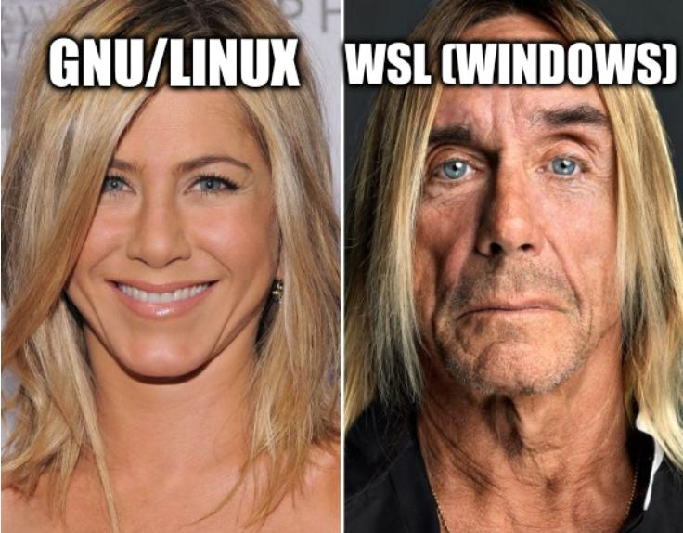
In-Class Exercise
Open the Lab Manual and Solve it

